Slide 1
TEMPLATES
Generic Programming!
Custom Comparison Operators
Templates
The Standard Template Library (STL)
STL Iterators
STL Algorithms (sort, etc.)
On-your-own Study:
Inline Functions, Template Exercise, More STL Algorithms

Slide 2
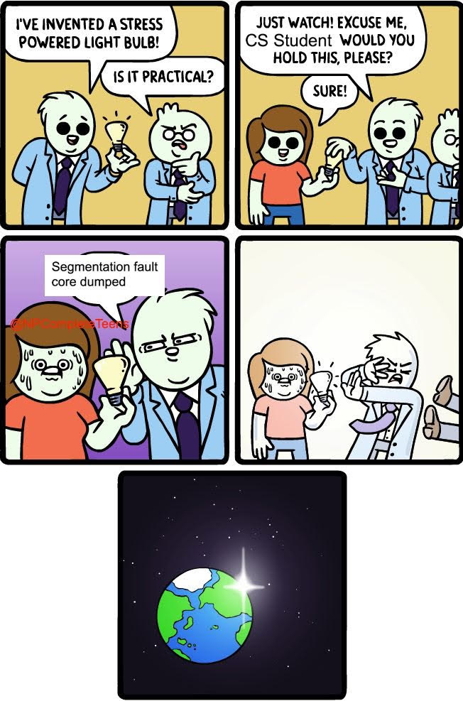
WRITES 50 DIFFERENT SORT FUNCTIONS
Implement polymorphism
in C++.
DATA WAS ALREADY SORTED

Slide 3
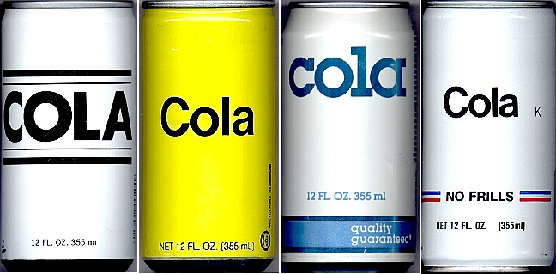
Generic Programming

Slide 4



Generic Programming Why should you care?
What if you could program 50x faster than everyone else?
That’s what generic programming is all about.
We’ll learn how to do stuff like:
Write a single generic function that can sort ANY type data
Write a linked list class that can hold ANY type of value
Define once, re-use infinitely
So pay attention!

Slide 5
Generic Programming
In this lecture, we’re going to learn about “Generic Programming”
The goal of GP is to build algorithms that are able to operate on many different types of data (not just a single type).
For example, a sort function that doesn’t just sort ints but can sort strings, ints, Student objects, etc.
Or a linked list class that doesn’t just hold Students, but can hold Students, ints, Robots, etc.
Once you define such a generic function or class, you can quickly reuse it to solve many different problems.

Slide 6
Part 1: Allowing Generic Comparisons
Consider the following main function that compares various objects to each other…
main()
{
int i1 = 3, i2 = 5;
if (i1 > i2)
cout << “i1 is bigger”;
Circ a(5), b(6);
if (a.radius() > b.radius())
cout << “a was bigger”;
Dog fido(10), spot(20);
if (fido.weight() >
spot.weight())
cout << “fido is bigger”;
}
Notice that the way we compare two dogs (by weight) is different than the way we compare two circles (by radius).
Wouldn’t it be nice if we could compare objects like circles and dogs just like we compare two integers?
if (a > b)
if (fido > spot)
cout << “fido is bigger”;
We can! Let’s see how!

Slide 7
Custom Comparison Operators
class Dog
{
public:
Since I’m defined inside the class, I can access private data too, like m_weight!
int getWeight() const
{ return m_weight; }
…
private:
int m_weight;
};
bool operator<(const Dog &other) const
{
if (m_weight < other.m_weight)
return true;
return false; // otherwise
}
Does it look familiar?
It’s just like an assignment operator, only it compares two objects instead of assigning one to another. You can define ==, <, >, <=, >= and !=
All comparison operators must return a Boolean value: true or false. In this example, our function should return true if a >= b., and false otherwise.
You can define a comparison operator for a class/struct like this…
All comparison operators accept const reference parameters.
(Leaving const out can cause compiler errors!)
Comparison operators defined outside the class have two parameters, one for each of the two operands.
if (a >= b) cout << “a is >= b\n”;
Your comparison function should compare object a against object b using whatever approach makes sense. Here we say dog a is greater than dog b if its weight is bigger.
Don’t forget to make it a const function – otherwise it won’t work when you compare const objects!
Comparison operators defined inside the class have a single “other” parameter, just like a copy constructor does. “other” refers to the value to the right of the operator:
if (a < other) …
If you like, you can also define your comparison operator inside your class…
Since I’m defined outside the class, I can only use public methods like getWeight()!
NOTE: If you define the operator outside of the class, it may only use public methods from your class!
bool operator>=(const Dog &a, const Dog &b)
{
if (a.getWeight() >= b.getWeight())
return true;
return false; // otherwise
}

Slide 8
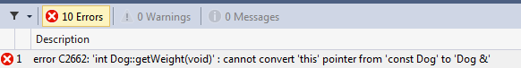
Custom Comparison Operators
And here’s how they work!
bool operator>=(const Dog &a, const Dog &b)
{
if (a.getWeight() >= b.getWeight())
return(true);
else return(false);
}
5
3
If you forget the const keyword…
Simply using the operator in your code causes C++ to call your comparison function!
class Dog
{
public:
int getWeight() const
{
return(m_weight);
}
...
private:
int m_weight;
};
Oh, and by the way… since a and b are const, our function can only call const functions in Dog!
So you’d better make getWeight() const too!
main()
{
Dog fido(5), spot(3);
if (fido >= spot)
cout << “fido wins”;
…
}
fido
weight
5
You’ll see this kind of cryptic error…
spot
weight
3
Notes:
You can’t define operator==/<=/etc for scalar types; at least one of the params must be a class type.

Slide 9
Part 2: Writing Generic Functions
// the old way
void SwapCircle(Circ &a, Circ &b)
{
Circle temp;
temp = a;
a = b;
b = temp;
}
void SwapDog(Dog &d1, Dog &d2)
{
Dog temp;
temp = a;
a = b;
b = temp;
}
main()
{
Circle a(5), b(6);
Dog c(100), d(750);
SwapCircle(a,b);
SwapDog(c,d);
}
In this code, we’ve written several different swap functions that swap the two values passed into the function.
// the new way
... (we’ll learn how in a sec)
main()
{
Circ a(5), b(6);
Dog c(10), d(75);
int e = 5, f = 10;
OurGenericSwap(a,b);
OurGenericSwap(c,d);
OurGenericSwap(e,f);
}
Wouldn’t it be nice if we could write one swap function and have it work for any data type?
We can!! Let’s see how!

Slide 10
The Solution
You can also use this alternate syntax… it’s entirely equivalent!
In C++, we use C++’s “template” feature to solve this problem.
template <class Item>
template <typename Item>
void swap(int &a, int &b)
{
int temp;
temp = a;
a = b;
b = temp;
}
To turn any function into a “generic function,” do this:
You can use any name you like for this!
Item
Item
Item
1. Add the following line above your function:
template <typename xxx>
poop>
foobar>
// use our templated func
main()
{
Dog d1(10), d2(20);
Circle c1(1), c2(5);
swap(d1,d2);
swap(c1,c2);
...
}
2. Then use xxx as your data type throughout the function:
swap(xxx a, xxx b)
Now you can use your generic function with any data type!

Slide 11
Function Template Details
Always place your templated functions in a header file.
Swap.H
template <typename Data>
void swap(Data &x, Data &y)
{
Data temp;
temp = x;
x = y;
y = temp;
}
Then include your header file in your CPP file(s) to use your function!
;
ERROR!
You must put the ENTIRE template function in the header file, not just the prototype!
MyCoolProgram.CPP
void main(void)
{
int a=5, b=6;
swap(a,b); // GOOD!
}
#include “Swap.h”

Slide 12
Function Template Details
main()
{
Dog a(13), b(41);
swap(a,b);
int p=-1, q=-2;
swap(p,q);
string x(“a"), y(“b");
swap(x,y);
int r=10, s=20;
swap(r,s); // ????
So you can think of templates as a time-saving/bug-reducing/source-simplifying technique rather than one that reduces the size of your compiled program.
Each time you use a template function with a different type of variable, the compiler generates a new version of the function in your program!
Question: How many versions of our function would be defined in this example?
#include “Swap.h”
main()
{
Dog a(13), b(41);
swap(a,b);
int p=-1, q=-2;
swap(p,q);
string x(“a"), y(“b");
swap(x,y);
int r=10, s=20;
swap(r,s); // ????
Swap.H
template <typename Data>
void swap(Data &x, Data &y)
{
Data temp;
temp = x;
x = y;
y = temp;
}
void swap(string &x,string &y)
{
string temp;
temp = x;
x = y;
y = temp;
}
void swap(Dog &x, Dog &y)
{
Dog temp;
temp = x;
x = y;
y = temp;
}
void swap(int &x, int &y)
{
int temp;
temp = x;
x = y;
y = temp;
}

Slide 13
Function Template Details
You MUST use the template data type (e.g. Data) to define the type of at least one formal parameter, or you’ll get an ERROR!
GOOD:
template <typename Data>
void swap(Data &x, Data &y)
{
Data temp;
temp = x;
x = y;
y = temp;
}
BAD:
template <typename Data>
Data getRandomItem(int x)
{
Data temp[10];
return(temp[x]);
}
Data used to specify the
types of x and y!
Data was not used to
specify the type of
any parameters.

Slide 14
Function Template Details
If a function has two or more “templated parameters,” with the same type (e.g. Data) you must pass in the same type of variable/value for both.
#include “max.h”
main()
{
}
MAX.H
template <typename Data>
Data max(Data x, Data y)
{
if (x > y)
return x;
else
return y;
}
int i = 5;
float f = 6.0;
cout << max(i,f); // ERROR!
Dog c;
Cat d, e;
e = max(d,c); // ERROR!
Notes:
The max(f,7.0) doesn’t work because one param is double and one is float

Slide 15
Function Template Details
And here’s a version of bigger that is just used for comparing dogs!
This function call will use the specialized version of bigger just for Dogs.
Why? If c++ sees a specialized version of a function, it will always choose it over the templated version.
Dog bigger(Dog &x, Dog &y)
{
if (x.bark() > y.bark())
return x;
else if (x.bark() < y.bark())
return y;
// barks are equal, check bite
if (x.bite() > y.bite())
return x;
else
return y;
}
You may override a templated function with a specialized (non-templated) version if you like.
Here’s a templated function to return the bigger of two items.
This function call will use the templated version of bigger.
template <typename Data>
Data bigger(Data &x, Data &y)
{
if (x > y)
return x;
else
return y;
}
int main()
{
Circle a, b, c;
c = bigger(a,b);
Dog fido, rex, winner;
winner = bigger(fido,rex);
}

Slide 16
A Hairy Template Example
If your templated function uses a comparison operator on templated variables…
bool operator>(const Dog &a,const Dog &b)
{
if (a.weight() > b.weight())
return(true);
else return(false);
}
Then C++ expects that all variables passed in will have that operator defined.
So if you use such a function with a user-defined class.
Since the > operator is defined for Dogs
bool operator>(const Circ &a,const Circ &b)
{
if (a.radius() > b.radius())
return(true);
else return(false);
}
And in this case, that’s OK, since C++ has built-in comparison operators defined for integers.
You must define a comparison operator for that class!
This > comparison will now work!
Don’t forget or you’ll suffer!
Like this…
template <typename Data>
void winner(Data &x, Data &y)
{
if (x > y)
cout << “first one wins!\n”;
else
cout << “second one wins!\n”;
}
main()
{
}
When we use the winner function with Dog objects!
int i1=3, i2=4;
winner(i1,i2);
Dog a(5), b(6);
winner(a,b);
// works!
Circ c(3), d(4);
winner(c,d);
// works!

Slide 17
Multi-type Templates
template <typename Type1, typename Type2>
void foo(Type1 a, Type2 b)
{
Type1 temp;
Type2 array[20];
temp = a;
array[3] = b;
// etc…
}
int main(void)
{
foo(5,”barf”); // OK!
foo(”argh”,6); // OK!
foo(42,52); // OK!
}
And yes, just in case you were guessing…
You can do this type of thing too…

Slide 18
Part 3: Writing Generic Classes
We can use templates to make entire classes generic too:
template <typename Item>
You must use the prefix:
class HoldOneValue
{
public:
void setVal(int a)
{
m_a = a;
}
void printTenTimes(void)
{
for (int i=0;i<10;i++)
cout << m_a;
}
private:
int m_a;
};
template <typename xxx>
Note that we don’t just update every int to an Item!
For example, in this case, int i is a counter variable (regardless of what type of data our class holds) so we leave it the same.
Item
before the class definition itself…
Then update the appropriate types in your class…
main()
{
HoldOneValue<int> v1;
v1.setVal(10);
v1.printTenTimes();
HoldOneValue<string> v2;
v2.setVal("ouch");
v2.printTenTimes();
}
Now your class can hold any type of data you like – just like the C++ stack or queue classes!
Item

Slide 19

In classes with externally-defined member functions, things get ugly!
PROFESSOR SPENDS 10 MINUTES ON SYNTAX
class Foo
{
public:
void setVal(int a);
void printVal(void);
private:
int m_a;
};
void Foo
{
m_a = a;
}
void Foo
{
cout << m_a << "\n";
}
You add the prefix:
template <typename Item>
template <typename xxx>
Item
before the class definition itself…
Item
AND before each function definition, outside the class.
template <typename Item>
THEN update the types to use your templated type…
<Item>
::setVal(int a)
Item
Finally, place the postfix:
THEN SAYS “YOU DON’T HAVE TO MEMORIZE THIS”
template <typename Item>
<xxx>
::printVal(void)
<Item>
Between the class name and the :: in all function defs.

Slide 20
Template Classes
Template classes are very useful when we’re building container objects like linked lists.
#include “linkedlist.h”
int main( )
{
Dog fido(10);
LinkedList<Dog> dogLst;
dogLst.insert(fido);
LinkedList<string> names;
names.insert(“Seymore”);
names.insert(“Butts”);
}
Before
class LinkedListofStrings
{
public:
LinkedListofStrings();
bool insert(string &value);
bool delete(string &value);
bool retrieve(int i, string &value);
int size(void);
~LinkedListofStrings();
private:
…
};
After
class LinkedListofDogs
{
public:
LinkedListofDogs();
bool insert(Dog &value);
bool delete(Dog &value);
bool retrieve(int i, Dog &value);
int size(void);
~LinkedListofDogs();
private:
…
};
template <class HoldMe>
class LinkedList
{
public:
LinkedList();
bool insert(HoldMe &value);
bool delete(HoldMe &value);
bool retrieve(int i, HoldMe &value);
int size(void);
~LinkedList();
private:
…
};

Slide 21
Template Cheat Sheet
To templatize a non-class function called bar:
Update the function header: int bar(int a) → template <typename ItemType> ItemType bar(ItemType a);
Replace appropriate types in the function to the new ItemType: { int a; float b; … } → {ItemType a; float b; …}
To templatize a class called foo:
Put this in front of the class declaration: class foo { … }; → template <typename ItemType> class foo { … };
Update appropriate types in the class to the new ItemType
How to update internally-defined methods:
For normal methods, just update all types to ItemType: int bar(int a) { … } → ItemType bar(ItemType a) { … }
Assignment operator: foo &operator=(const foo &other) → foo<ItemType>& operator=(const foo<ItemType>& other)
Copy constructor: foo(const foo &other) → foo(const foo<ItemType> &other)
For each externally defined method:
For non inline methods: int foo::bar(int a) → template <typename ItemType> ItemType foo<ItemType>::bar(ItemType a)
For inline methods: inline int foo::bar(int a) → template <typename ItemType> inline ItemType foo<ItemType>::bar(ItemType a)
For copy constructors and assignment operators
foo &foo::operator=(const foo &other) → foo<ItemType>& foo<ItemType>::operator=(const foo<ItemType>& other)
foo::foo(const foo &other) → foo<ItemType>::foo(const foo<ItemType> &other)
If you have an internally defined struct blah in a class: class foo { … struct blah { int val; }; … };
Simply replace appropriate internal variables in your struct (e.g., int val;) with your ItemType (e.g., ItemType val;)
If an internal method in a class is trying to return an internal struct (or a pointer to an internal struct):
You don’t need to change the function’s declaration at all inside the class declaration; just update variables to your ItemType
If an externally-defined method in a class is trying to return an internal struct (or a pointer to an internal struct):
Assuming your internal structure is called “blah”, update your external function bar definitions as follows:
blah foo::bar(…) { … } → template<typename ItemType>typename foo<ItemType>::blah foo<ItemType>::bar(…) { … }
blah *foo::bar(…) { … } → template<typename ItemType>typename foo<ItemType>::blah *foo<ItemType>::bar(…) { … }
Try to pass templated items by const reference if you can (to improve performance):
Bad: template <typename ItemType> void foo(ItemType x)
Good: template <typename ItemType> void foo(const ItemType &x)

